Slide 1


MIT School of Computing
Department of Computer Science & Engineering
Third Year Engineering
23CSE3011 - Design and Analysis of Algorithms
Class - T.Y. (SEM-V)
Unit - IV
Backtracking & Branch-n-Bound
PLD
AY 2026-2027 SEM-V

Slide 2
Dept. of Computer Science & Engineering.
UNIT - IV SYLLABUS
Backtracking: Principle, algorithms: n-queen problem introduction, 4-queen problem solving using state space tree, sum of subsets problem introduction and problem solving using state space tree
Branch-and-Bound: Principle, algorithms: Branch and bound strategies FIFO, LIFO and LC approaches, TSP using branch and bound technique, knapsack problem using branch and bound technique

Slide 3

BACKTRACKING: PRINCIPLE
Dept. of Computer Science & Engineering.
Backtracking is a technique used to solve problems with a large search space, by systematically trying and eliminating possibilities.
A standard example of backtracking would be going through a maze.
At some point, you might have two options of which direction to go:
Portion B
Junction
Portion A

Slide 4
BACKTRACKING [Cont…]
Dept. of Computer Science & Engineering.
One strategy would be to try going through Portion A of the maze.
  If you get stuck before you find your way out, then you "backtrack" to the junction.
At this point in time you know that Portion A will NOT lead you out of the maze,
  So you then start searching in Portion B
Portion B
Junction
Portion A

Slide 5
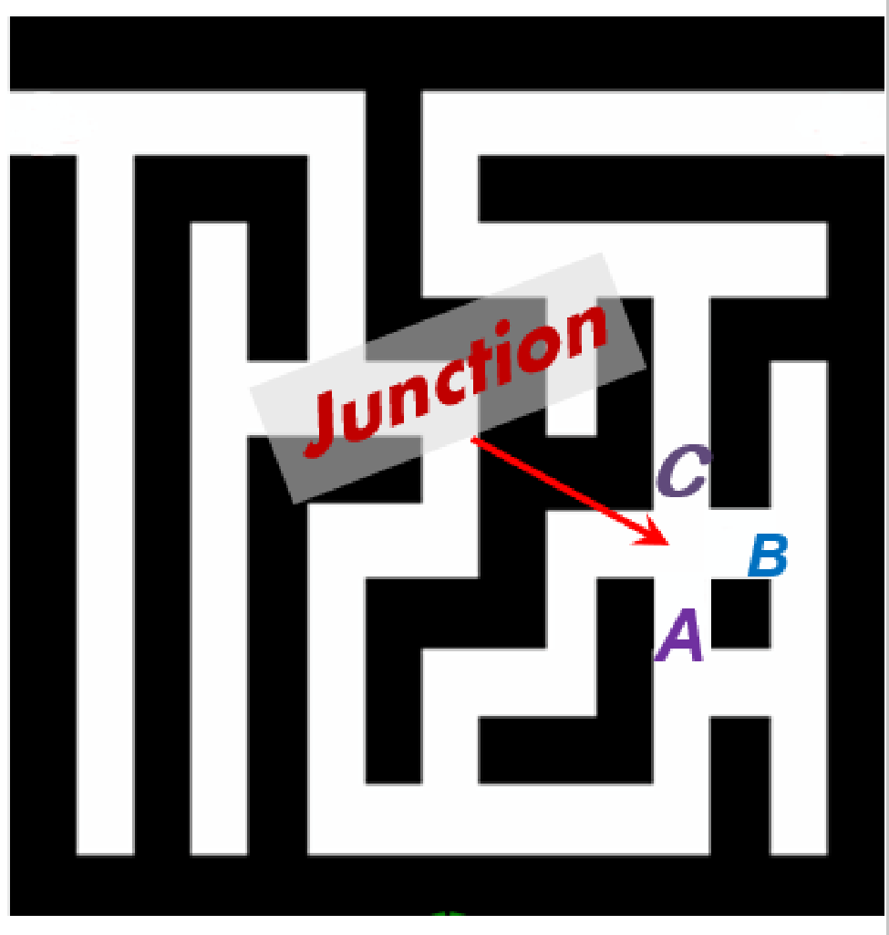
BACKTRACKING [Cont…]
Dept. of Computer Science & Engineering.
Clearly, at a single junction you could have even more than 2 choices.
The backtracking strategy says to try each choice, one after the other,
  if you ever get stuck, "backtrack" to the junction and try the next choice.
If you try all choices and never found a way out, then there is no solution to the maze.

Slide 6
BACKTRACKING [CONT…]
Dept. of Computer Science & Engineering.
dead end
?
dead end
dead end
?
start
?
?
dead end
dead end
?
success!

Slide 7
Unit 4 - Outline
Dept. of Computer Science & Engineering.
Backtracking
n-queen problem
Sum of subsets problem
Branch-n-Bound: Principle
Strategies: FIFO, LIFO and LC approaches
Travelling Salesperson Problem
Knapsack problem

Slide 8
N-QUEEN PROBLEM
Dept. of Computer Science & Engineering.
Problem surfaced in 1848 by chess player Max Bezzel as 8 queens
(regulation board size)
Premise is to place N queens on N x N board so that they are
non-attacking
A queen is one of six different chess pieces
It can move forward & back, side to side and to its diagonal and
anti-diagonals
The problem: given N, find all solutions of queen sets and return
either the number of solutions and/or the patterned boards.

Slide 9
BASIC ALGORITHM: N-QUEEN PROBLEM
Dept. of Computer Science & Engineering.
In this problem, a chessboard will be given of 4 X 4 (i.e., 16 cells)
For 4 X 4 chessboard, we have 4 queens to place in the chessboard.
So, just like in the game of chess, a queen can move in horizontal
(i.e., row-wise), vertical (i.e., column-wise) and diagonal direction.
So, according to our problem, we have to place all the 4 queens in such a way that no two queens are under attack.
When two queens are in the same row/column/diagonal, we call they are under attack.

Slide 10
BASIC ALGORITHM: N-QUEEN PROBLEM
Dept. of Computer Science & Engineering.
Generate a list of free cells on the next row.
If no free cells, backtrack (step 2 of previous row)
Place a queen on next free cell & proceed with step 1 for next row
If no next row, proceed to step 3
At this point, you have filled all rows, so count/store as a solution

Slide 11
BASIC ALGORITHM: EXAMPLE
Dept. of Computer Science & Engineering.
Total no. of ways by which we can arrange all the four queens in the 16 cells are ¹⁶C₄ ways
1 | 2 | 3 | 4
1
2
3
4

Slide 12
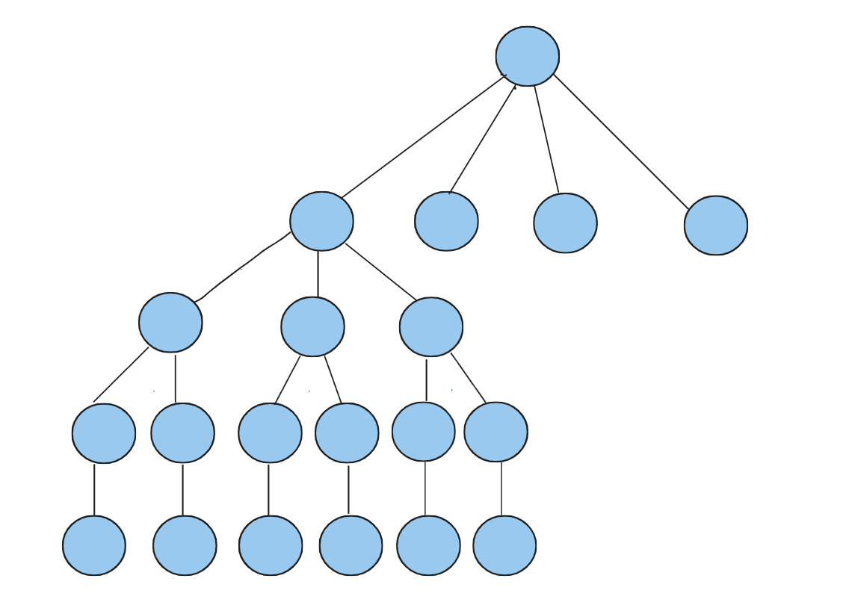
BASIC ALGORITHM: EXAMPLE
Dept. of Computer Science & Engineering.
So, let us generate a state-space tree:

Slide 13
BASIC ALGORITHM: EXAMPLE
Dept. of Computer Science & Engineering.
So, let us generate a state-space tree:
Total number of nodes =

Slide 14
BASIC ALGORITHM: EXAMPLE
Dept. of Computer Science & Engineering.
So, let us generate a state-space tree:

Slide 15
BASIC ALGORITHM: EXAMPLE
Dept. of Computer Science & Engineering.
F | F | F | F | F
Q
Q
 |  | F | F | F
Q
 |  | Q

Slide 16
BASIC ALGORITHM: EXAMPLE
Dept. of Computer Science & Engineering.
Q
 |  | Q
 |  |  |  | F
Q
 |  | Q
 |  |  |  | Q
Q
 |  | Q
 |  |  |  | Q
 | F
Q
 |  | Q
 |  |  |  | Q
 | Q

Slide 17
BASIC ALGORITHM: EXAMPLE
Dept. of Computer Science & Engineering.
Q
 |  | Q
 |  |  |  | Q
 | Q
 |  |  | F
Q
 |  | Q
 |  |  |  | Q
 | Q
 |  |  | Q
DONE

Slide 18
Unit 4 - Outline
Dept. of Computer Science & Engineering.
Backtracking
n-queen problem
Sum of subsets problem
Branch-n-Bound: Principle
Strategies: FIFO, LIFO and LC approaches
Travelling Salesperson Problem
Knapsack problem

Slide 19
SUM OF SUBSETS
Dept. of Computer Science & Engineering.
In this problem, a set of weights will be given
We have to take subset of those weights such that their sum is exactly equal to a value m
The solution set is represented as 0/1 form

Slide 20
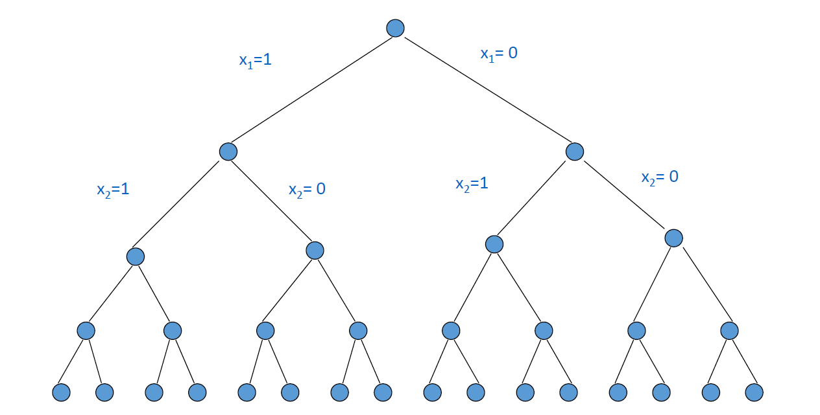
SUM OF SUBSETS
Dept. of Computer Science & Engineering.
Each forward and backward moves take O(1) time

Slide 21
SUM OF SUBSETS
Dept. of Computer Science & Engineering.
W[1:6] = {5, 10, 12, 13, 15, 18}
n=6, m=30; where n is the number of number of weights, m is the target value
So, selection of the above weights can be done in various ways.
Hence, let us try all possible ways of their selection and find out which
of those selection is giving us the exact value of m (i.e., equals to 30)
To solve the problem, we will have to draw a state-space tree for the
problem

Slide 22
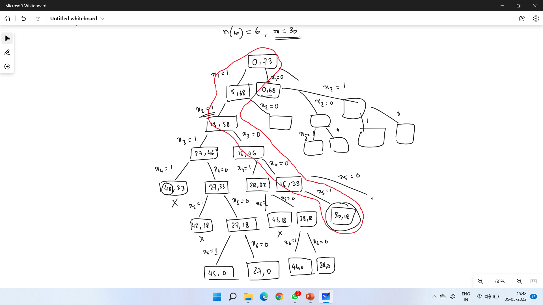
SUM OF SUBSETS: Example [Cont..]
Dept. of Computer Science & Engineering.

Slide 23
Unit 4 - Outline
Dept. of Computer Science & Engineering.
Backtracking
n-queen problem
Sum of subsets problem
Branch-n-Bound: Principle
Strategies: FIFO, LIFO and LC approaches
Travelling Salesperson Problem
Knapsack problem

Slide 24
BRANCH AND BOUND: PRINCIPLE
Dept. of Computer Science & Engineering.
Branch and bound builds the state-space tree and find the optimal solution quickly by pruning few of the tree branches which does not satisfy the bound.
Backtracking can be useful when some other optimization techniques like greedy or dynamic programming fail. Such algorithms are typically slower than their counterparts.
In the worst case, it may run in exponential time, but careful selection of bounds and branches makes an algorithm to run reasonably faster.

Slide 25
BRANCH AND BOUND: PRINCIPLE
Dept. of Computer Science & Engineering.
Branch and bound approach is used to solve minimization problems and not maximization problems
Anyway, we can convert a maximization problem to minimization problem and solve it.
One example of minimization optimization problem is Job sequencing with deadline where we need to pay the penalty for not doing a job instead of earning profits for doing a job.

Slide 26
Unit 4 - Outline
Dept. of Computer Science & Engineering.
Backtracking
n-queen problem
Sum of subsets problem
Branch-n-Bound: Principle
Strategies: FIFO, LIFO and LC approaches
Travelling Salesperson Problem
Knapsack problem

Slide 27
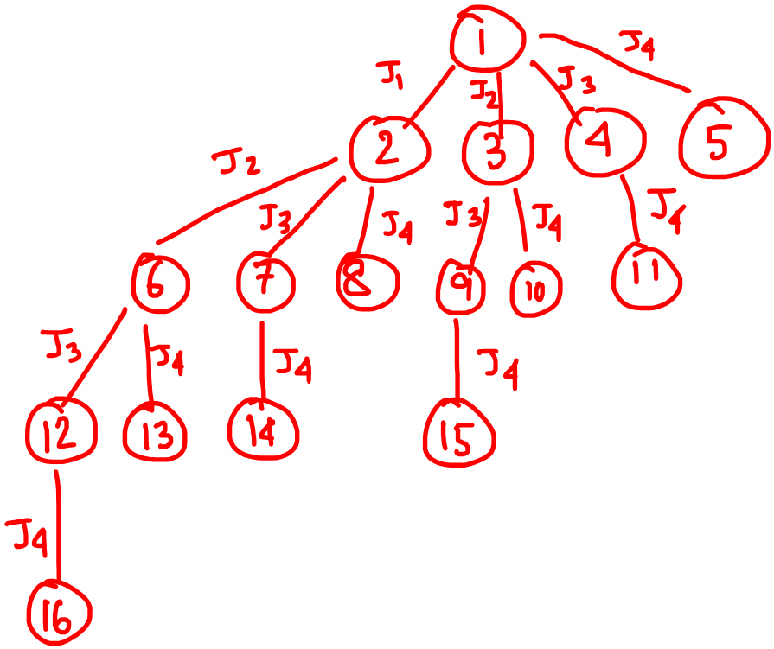
BRANCH AND BOUND STRATEGIES: FIFO
Dept. of Computer Science & Engineering.
Instead of generating entire tree,
we always pick-up the nodes with minimum cost/least cost and try to explore that one,
so that quickly we can reach the solution.

Slide 28
Unit 4 - Outline
Dept. of Computer Science & Engineering.
Backtracking
n-queen problem
Sum of subsets problem
Branch-n-Bound: Principle
Strategies: FIFO, LIFO and LC approaches
Travelling Salesperson Problem
Knapsack problem

Slide 29
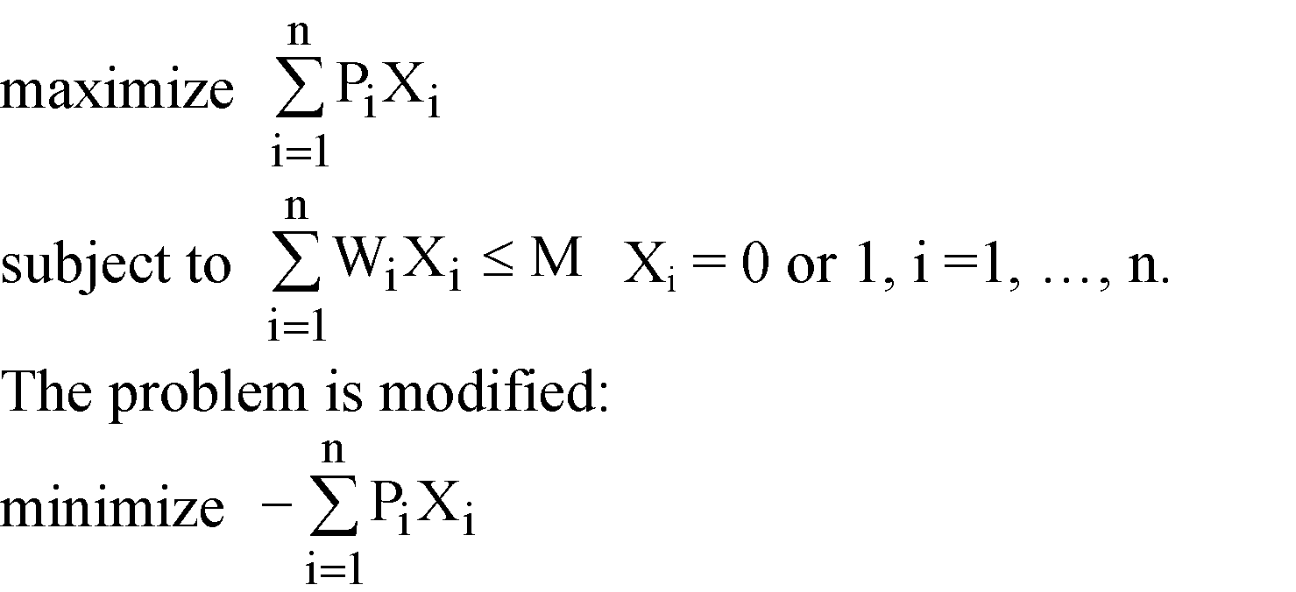
THE 0/1 KNAPSACK PROBLEM
Dept. of Computer Science & Engineering.
Positive integer P₁, P₂, …, P_{n} (profit)
W₁, W₂, …, W_{n} (weight)
M (capacity)

Slide 30
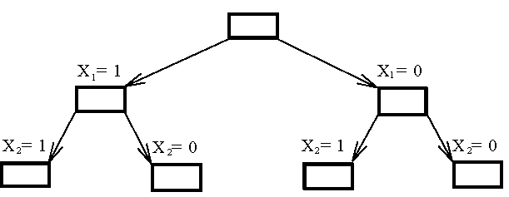
THE 0/1 KNAPSACK PROBLEM [Cont...]
Dept. of Computer Science & Engineering.
Fig. 6-27 The Branching Mechanism in the Branch-and-Bound Strategy to Solve 0/1 Knapsack Problem.

Slide 31
HOW TO FIND THE UPPER BOUND?
Dept. of Computer Science & Engineering.
By quickly finding a feasible solution in a greedy manner -
“starting from the smallest available i, scanning towards the largest i’s until M is exceeded. The upper bound can be calculated.”

Slide 32
THE 0/1 KNAPSACK PROBLEM
Dept. of Computer Science & Engineering.
E.g. n = 6, M = 34
A feasible solution: X₁ = 1, X₂ = 1, X₃ = 0, X₄ = 0,
X₅ = 0, X₆ = 0
-(P₁+P₂) = -16 (upper bound)
Any solution higher than -16 can not be an optimal solution.
i
1
2
3
4
5
6
P_{i}
6
10
4
5
6
4
W_{i}
10
19
8
10
12
8
(P_{i}/W_{i} ≥ P_{i+1}/W_{i+1})

Slide 33
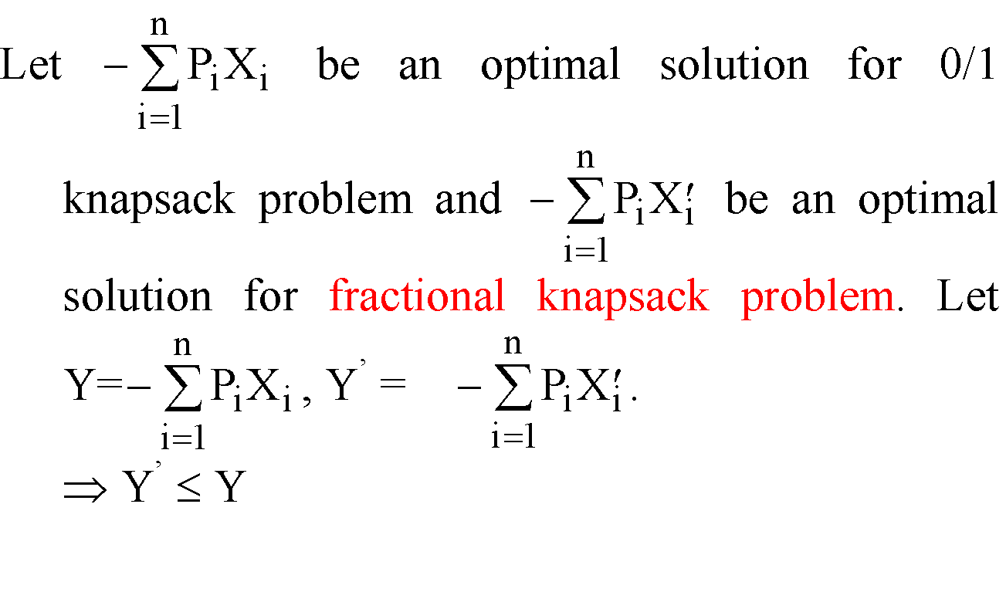
HOW TO FIND THE LOWER BOUND?
Dept. of Computer Science & Engineering.
By relaxing our restriction from X_{i} = 0 or 1 to 0 ≤ X_{i} ≤ 1 (knapsack problem)

Slide 34
Dept. of Computer Science & Engineering.
THANK YOU

